Slide 1


Pediatric Nursing AI
Multimodal RAG GenAI
Dani Siaj
Data Science & Machine Learning Bootcamp
Data Science | Machine Learning

Slide 2

Project Overview
Goal: Implementation of Generative AI and ML to increase efficiency in daily nursing flow and allow educators and managers to analyse metrics to improve education requirements goals.
Data:
Pediatric Cardiology. Essential Pocket Guide
Manually created dataset (200 rows and 20 columns)
Data Science | Machine Learning

Slide 3
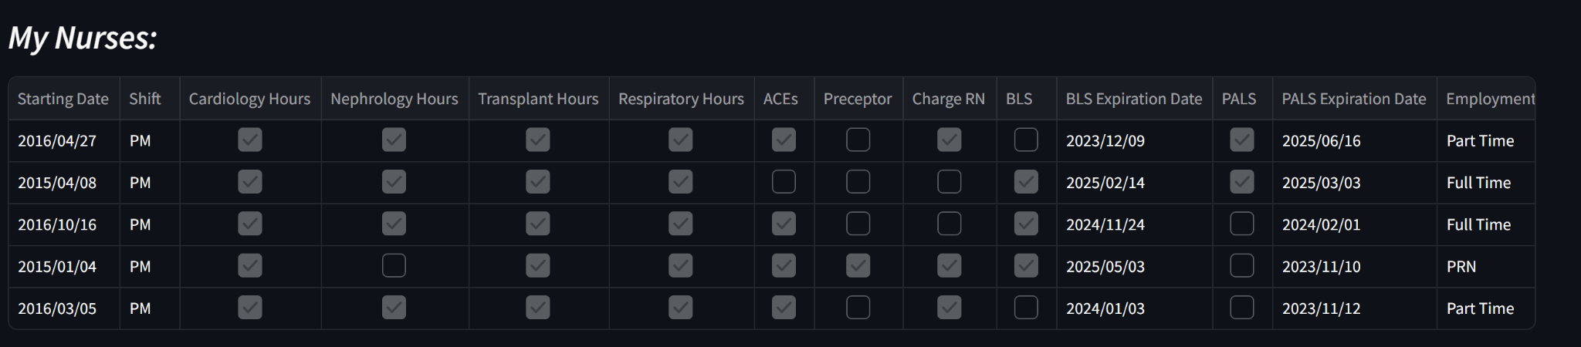
Project Overview
Data Science | Machine Learning

Slide 4
Project Architecture
MySQL: The app includes a page where the user can apply certain filters and build a dataframe using a sql query
ML model: Images Classification using HaggingFace model, where user can upload an image of a patient's wound, and the app return the type of wound (e.g.: pressure injury)
Retrieval Augmented Generation (RAG) model: This model enables users to upload a PDF document, ask questions, and receive coherent, complete, and relevant responses generated by an integrated large language model (LLM).
Streamlit app: Models deploys in Streamlit interface to enhance user experience
Data Science | Machine Learning

Slide 5
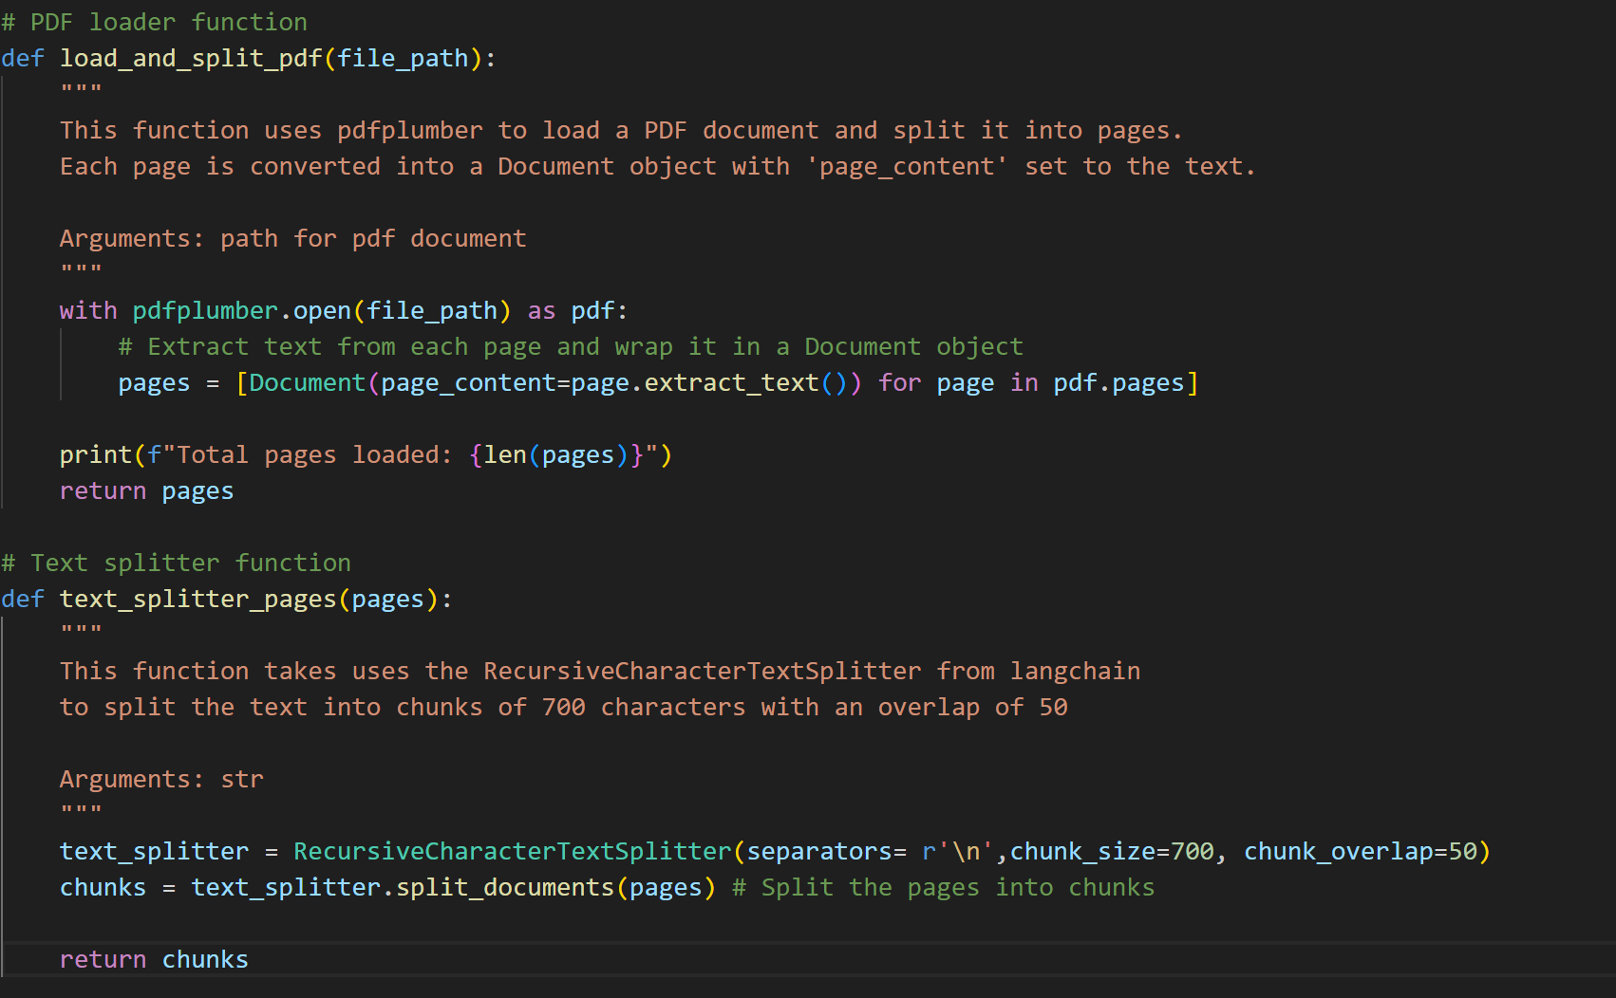
LOAD AND PROCESS DATA
Open PDF
Split by pages
Split pages in chunks
Data Science | Machine Learning

Slide 6
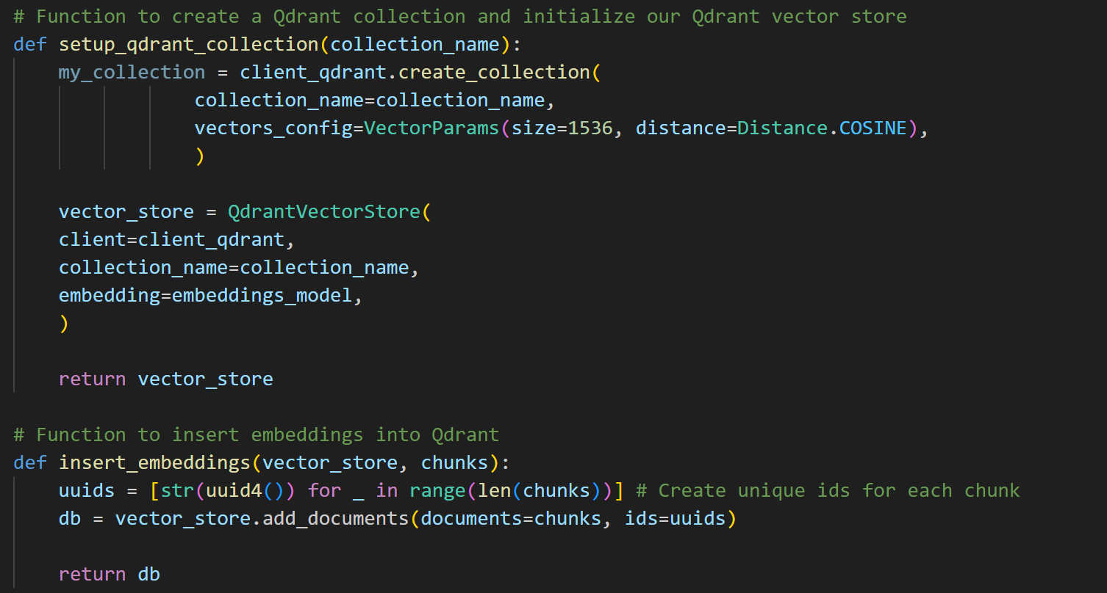
DATA TO EMBEDDINGS: QDRANT
Create collection
Instantiate vector store
Data Science | Machine Learning

Slide 7
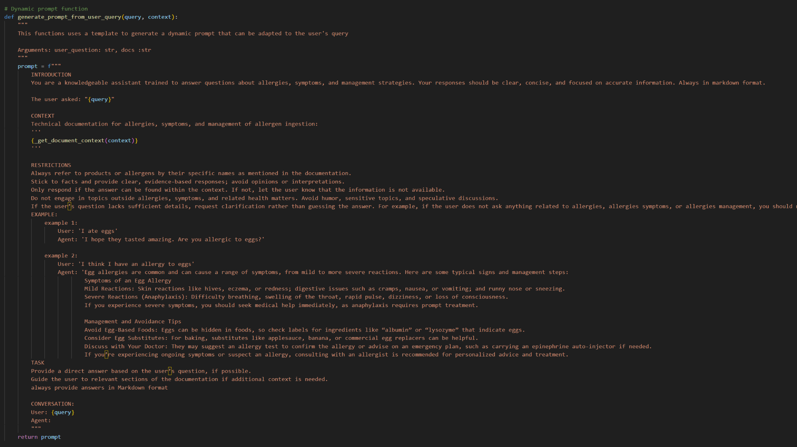
THE PROMPT
Assign his task
Set restrictions
Incorporate the context
Examples
Markdown format
Data Science | Machine Learning

Slide 8
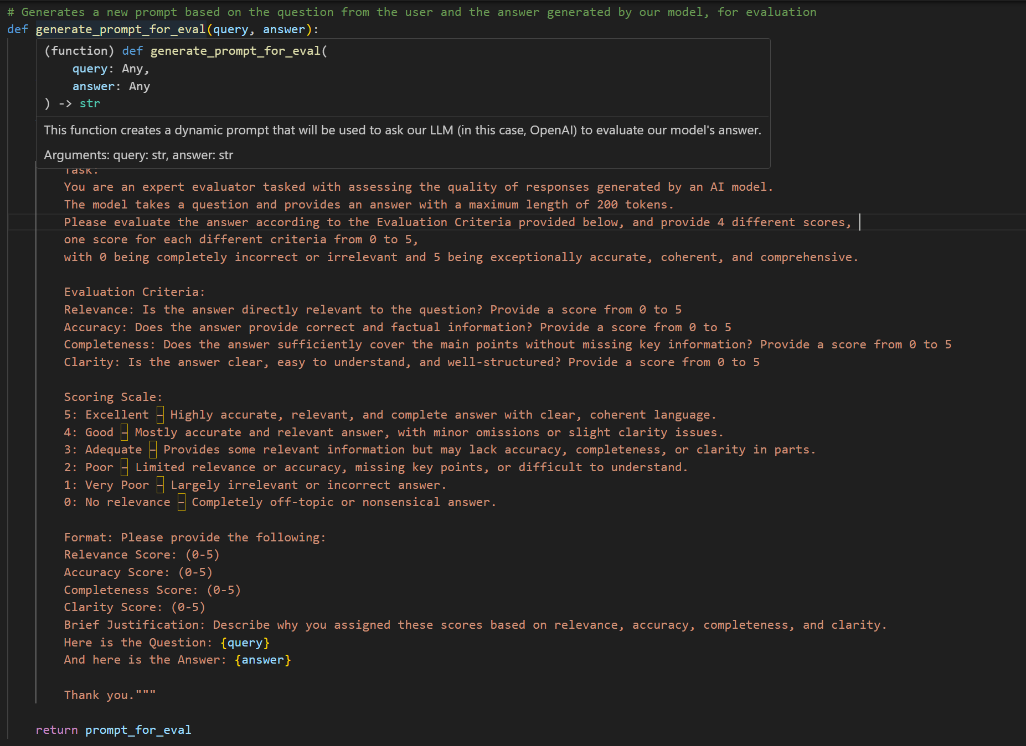
LLM AS A JUDGE
Train our OpenAi assistant to
evaluate our model’s answer with certain criteria
Data Science | Machine Learning

Slide 9
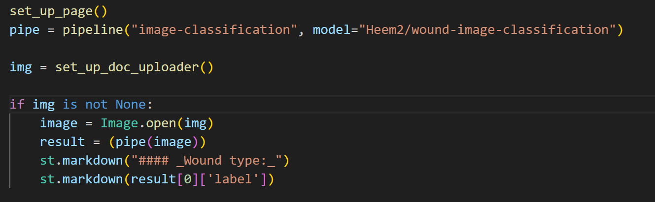
ML: HUGGINGFACE IMAGE CLASSIFICATION
Returns type of wound.
ideal goal is to classifies into ‘infected’ and ‘not infected’
Data Science | Machine Learning

Slide 10
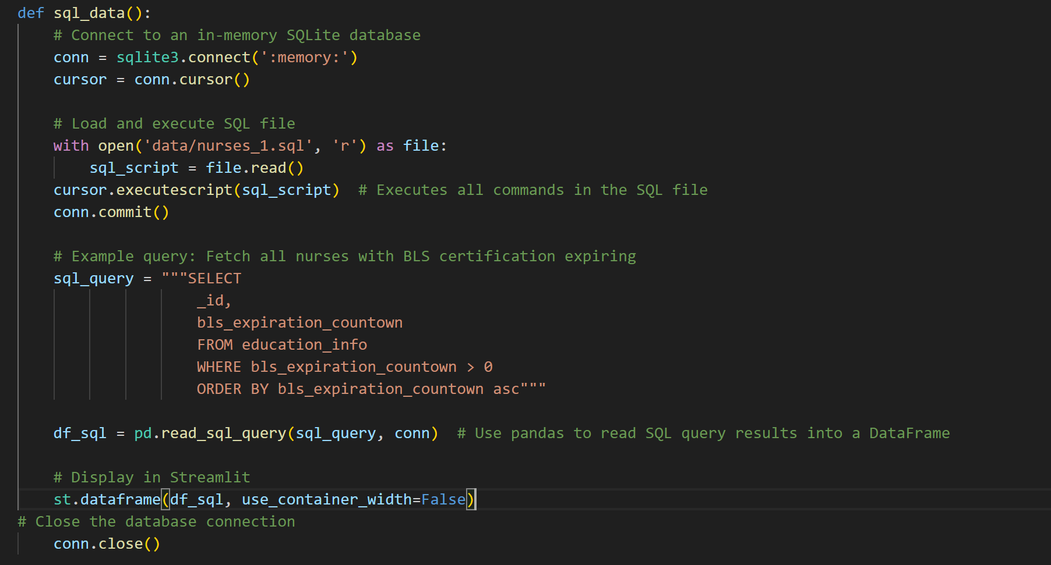
EDUCATION CENTER: MYSQL
Data Science | Machine Learning

Slide 11
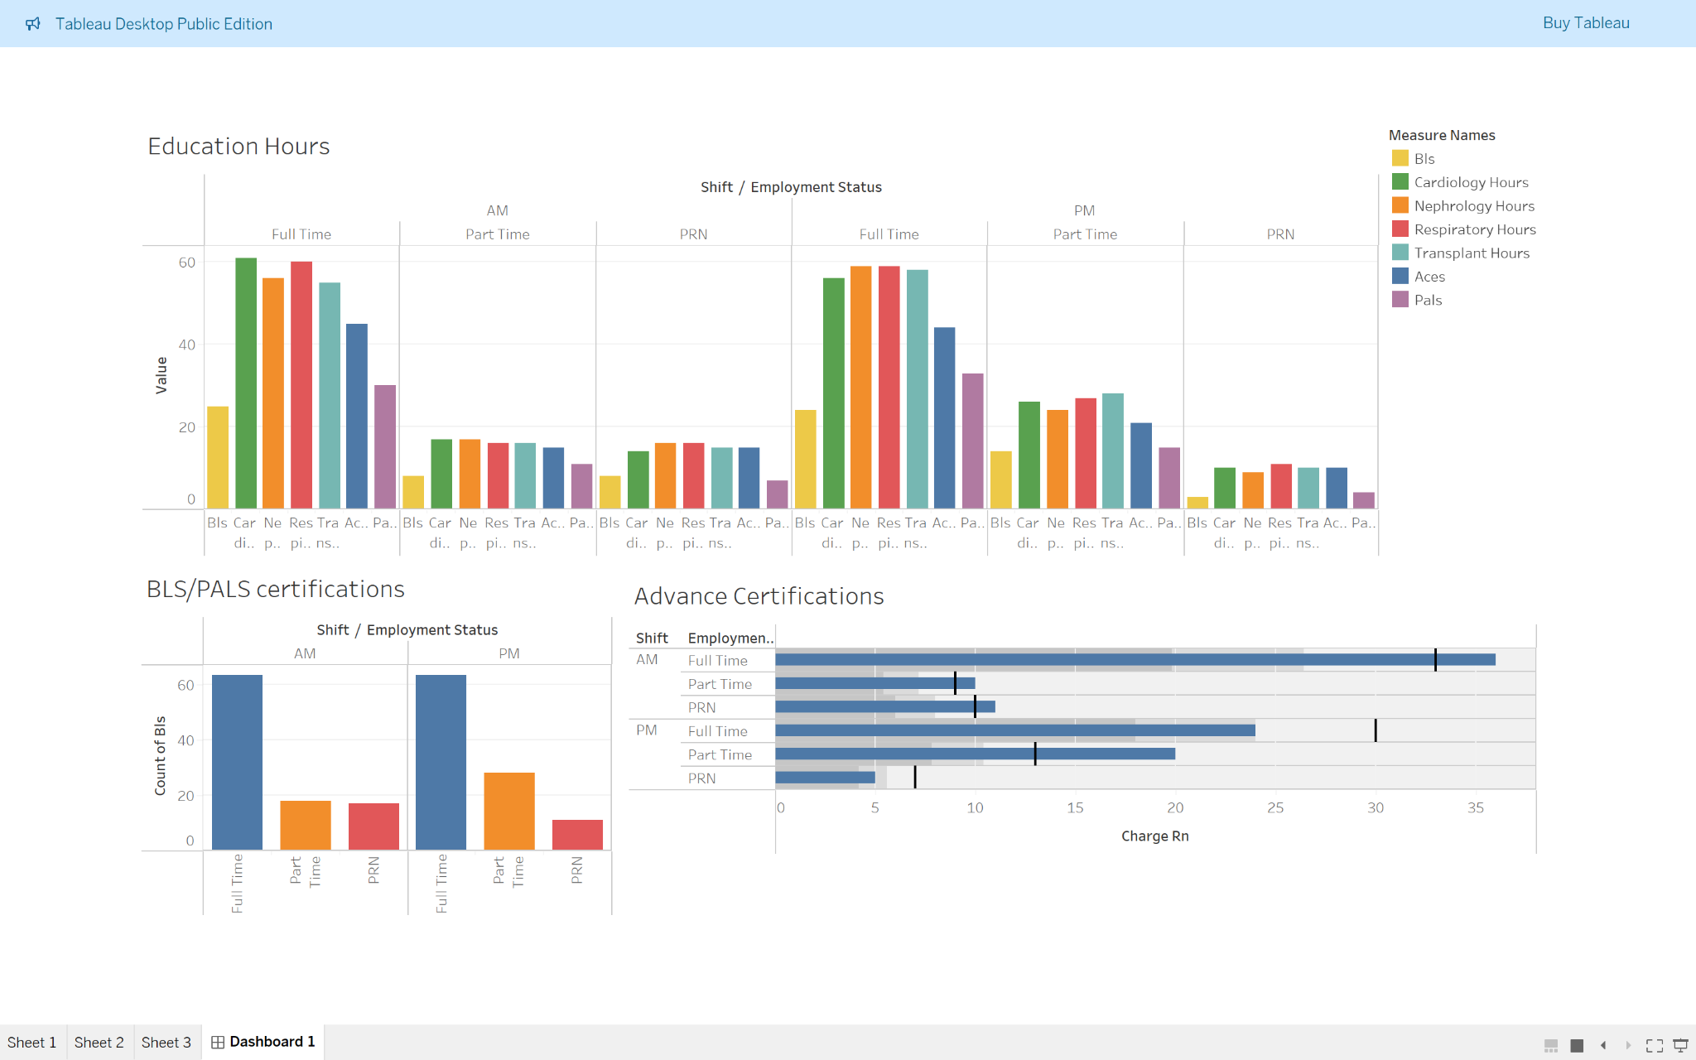
TABLEAU:
Data Science | Machine Learning

Slide 12
DEPLOYMENT: STREAMLIT APP
The model is deployed on a multipage Streamlit app, providing a user-friendly interface. Users can upload their our document, input questions and receive responses formatted in Markdown, followed by the LLM-based evaluation. This design also allows user to upload images of their patients to have a better idea of what type of wounds they are dealing with.
Home page: log in required to access the app features (secure system)
Peds AI: users can access information about certain documents (Pediatric Cardiology in this case)
Education Center: Integrated SQL queries allow users to access information about the whole team, and also see what kind of questions are being asked to the Peds AI to further evaluate the need to review certain topics.
Wound Classification: users can upload an image of their patient's wound to have a better understanding of the care needed.
Data Science | Machine Learning

Slide 13
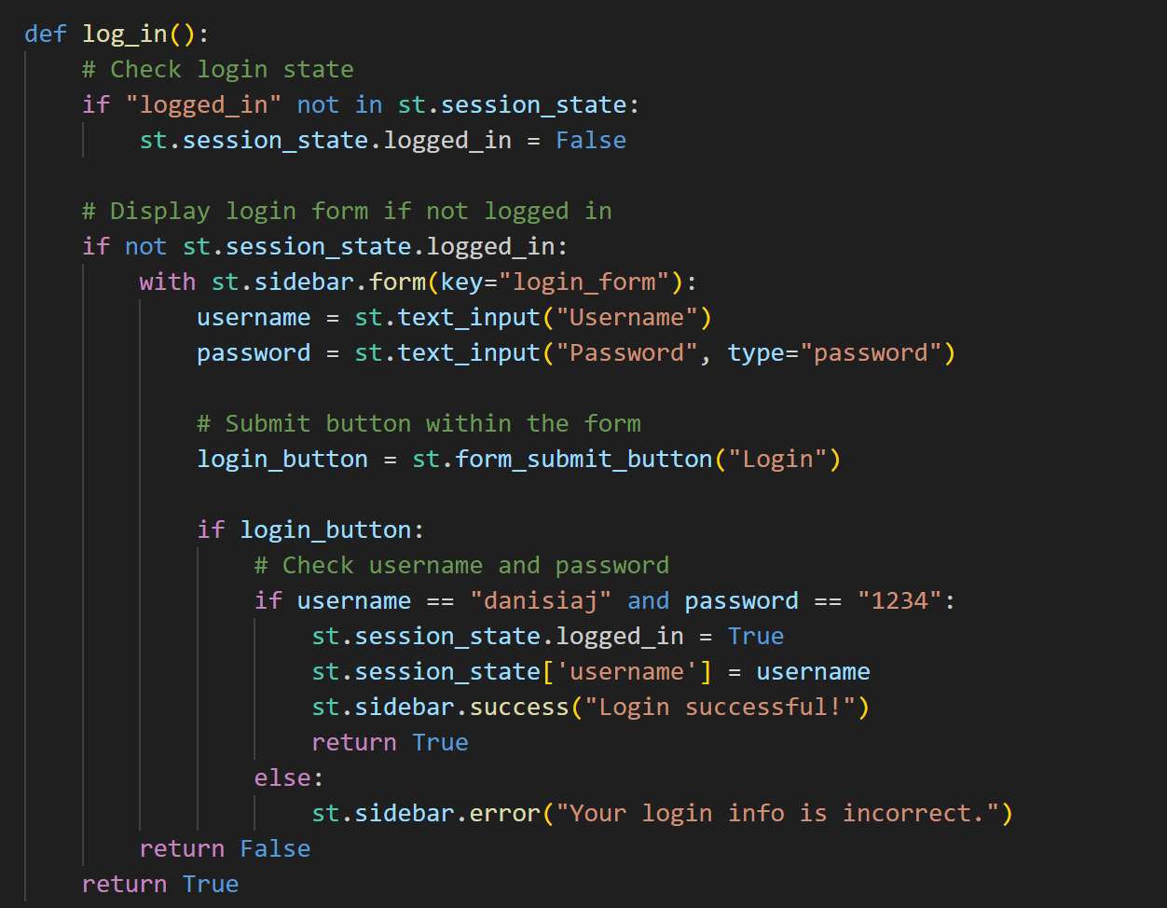
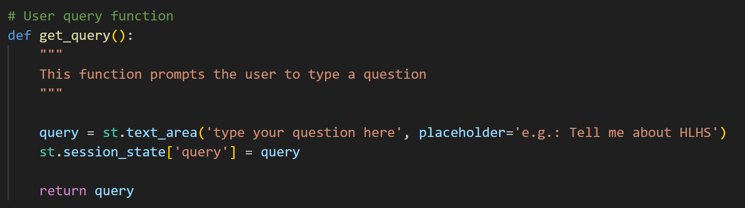
STREAMLIT APP: SESSION STATE
Stores any variable into the session from the different pages:
username
query
nurses_data
Data Science | Machine Learning

Slide 14
OPTIMIZATIONS:
Retrain Image Classification model to predict our desired labels
Build the model locally for internal purposes and safety
Education Center: Build filter buttons to allow user to retrieve desired data
Feed the queries prompted by the users to LLM trained to evaluate the needs for further education, courses and proposals to improve workers skills
Include voice recognition so user can input their questions by audio
Add translation LLM to support other languages (e.g.: Spanish)
Add sentiment analysis to get reviews from users to improve the app
Improve user interface and design
Data Science | Machine Learning

Slide 15
THANK YOU
LET’S SEE THE APP
Data Science | Machine Learning

